Slide 1
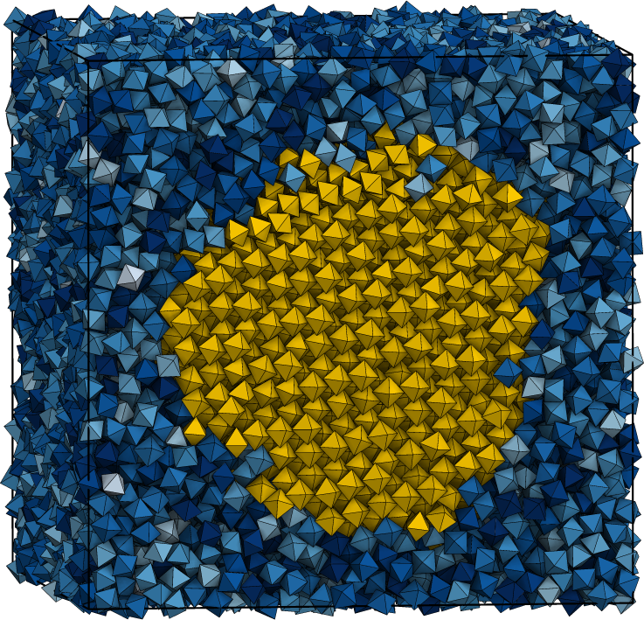
Crystallization in Systems of Hard Polyhedra
Dissertation Defense of Richmond S. Newman
Committee Members: Sharon C. Glotzer, Robert M. Ziff,
Michael J. Solomon, and John Kieffer

Slide 2
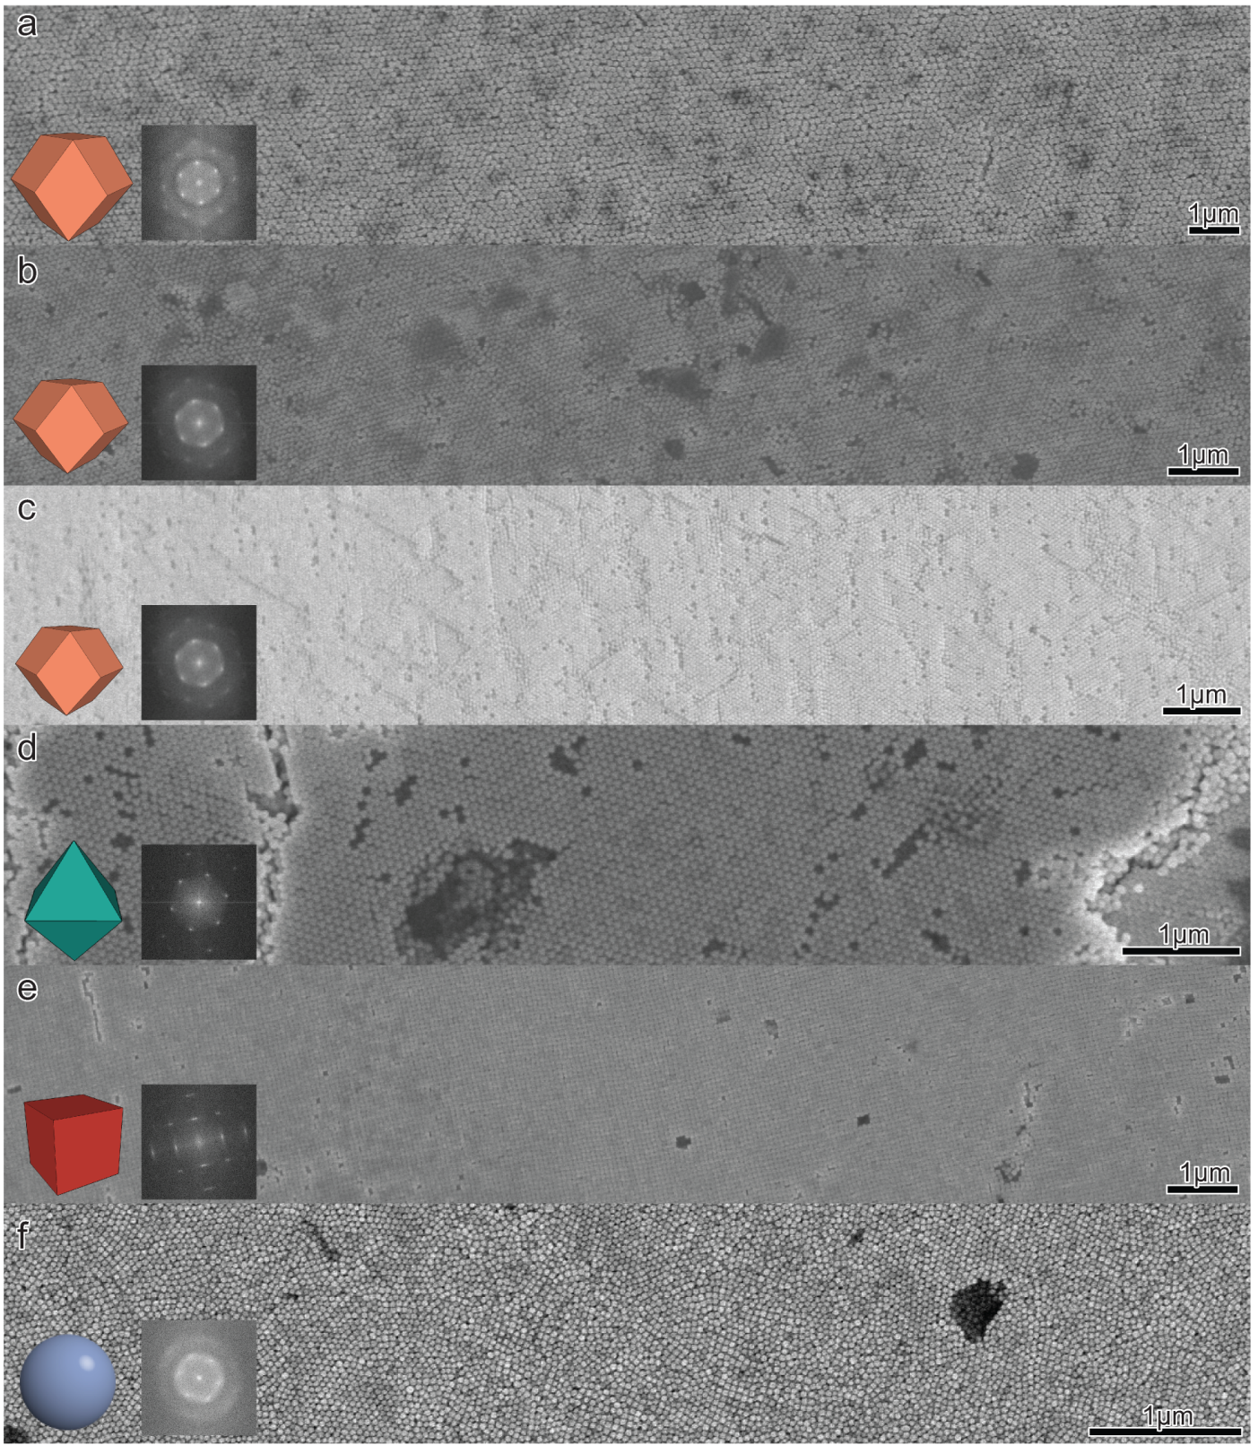
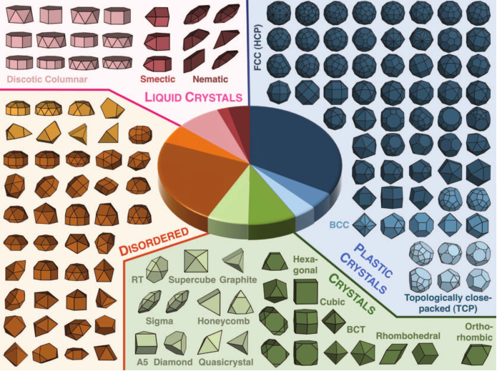
Polyhedra Self-Assemble
(above)
P. F. Damasceno, M. Engel, and S. C. Glotzer, “Predictive Self-Assembly of Polyhedra into Complex Structures,” Science (80-. )., vol. 337, no. 6093, pp. 453–457, Jul. 2012.
(left)
Jianxiao Gong, Richmond S. Newman, Michael Engel, Sharon C. Glotzer, Zhiyong Tang. “Shape-Dependent Ordering of Gold Nanocrystals into Large-Scale Superlattices,” Nature Comm 2016, submitted

Slide 3
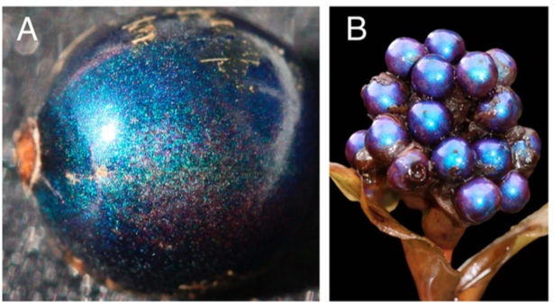
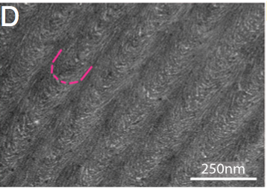
Material properties and lengthscale
Material properties depend on material length scales
  Colloidal systems can make crystals on scales between 20 nm-1μm.
Ordered metal nanoparticles (Ag, Au) exhibit surface plasmon resonance
  Applications to spectroscopy and catalysis
Light interacts and scatters in crystals with similar wavelengths;
Example: Pollia fruit, shown below contain no blue pigments
Vignolini, S., Rudall, P. J., Rowland, a. V., Reed, A., Moyroud, E., Faden, R. B., … Steiner, U. (2012). Pointillist structural color in Pollia fruit. Proceedings of the National Academy of Sciences, 109(39), 15712–15715. doi:10.1073/pnas.1210105109
Notes:
Blue is the pollia fruit, whose color comes from bragg reflection of cellulose microfibrils.

Slide 4
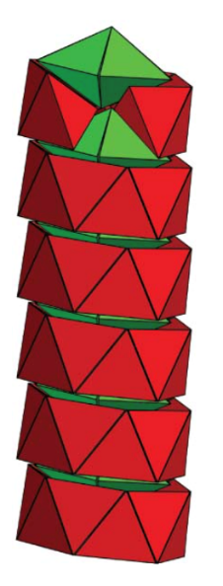
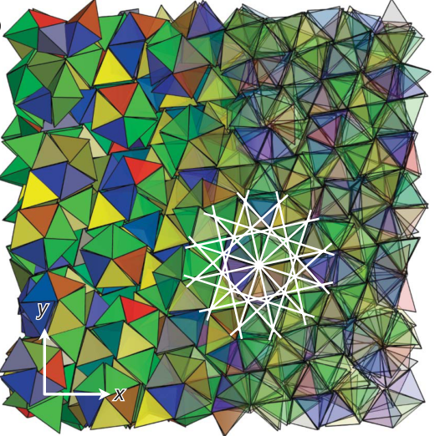

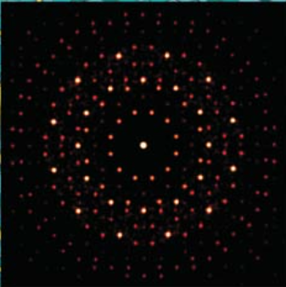
Why self-assembly?
Numbers required to reach bulk materials:
  An ordered 1 cm³ volume from 100nm cubes requires 10¹⁵ particles
Self-assembly can form structures not available to top-down nanoscale fabrication methods, like lithography, film deposition and etching
Haji-Akbari, A., Engel, M., Keys, A. S., Zheng, X., Petschek, R. G., Palffy-Muhoray, P., & Glotzer, S. C. (2009). Disordered, quasicrystalline and crystalline phases of densely packed tetrahedra. Nature, 462(7274), 773–777.

Slide 5
Overview
Today we will discuss the contributions of simulation to understanding the formation of superlattices in experimental via two case studies:
  Case 1: Self-assembly of bipyramids
  Case 2: Shape-dependent assembly of rhombic dodecahedra, cubes, and octahedra into large-scale superlattices
Following, we discuss simulations of the crystal nucleation process
  Case 3: Faceting, free energy barriers to nucleation, and entropic forces

Slide 6

Case 1:
A Study of Bipyramids
Size- and Shape-Controlled Synthesis of Doped LiYF₄ Upconversion Nanophosphors and their Shape-Directed Self-Assembly
Xingchen Ye, Joshua E. Collins, Richmond S. Newman, Michael Engel, Jun Chen, Guozhong Xing, Cherie R. Kagan, Sharon C. Glotzer, and Christopher B. Murray. JACS, in preparation.

Slide 7
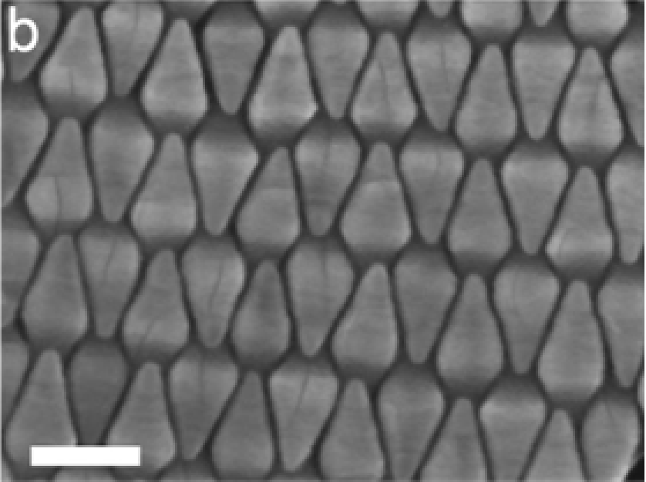
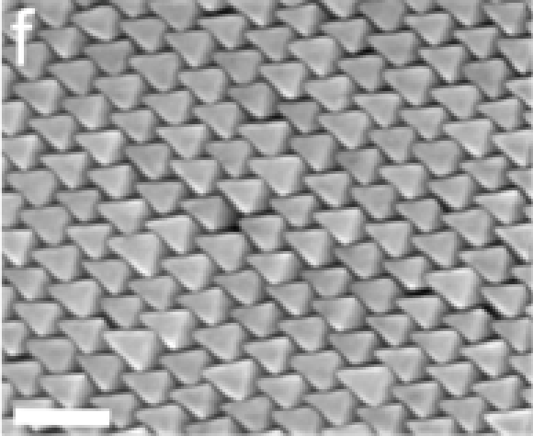
Competing Phases
Goal: understand driving forces for LiYF₄ bipyramids particles on a 2D interface to assemble either antiparallel or parallel striped phases
100nm
100nm

Slide 8
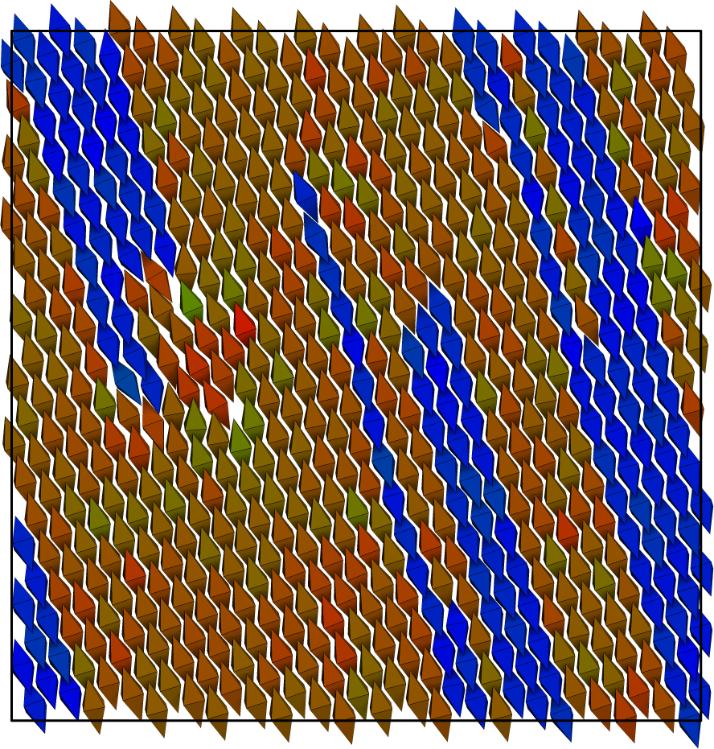
Simulation Model
Model as hard polyhedra in Monte Carlo
Need to confine particles to be quasi-2D
  Apply stiff harmonic spring for vertices outside a narrow window
  (k_{z}=100, 𝛿_{z}=0.7)

Slide 9
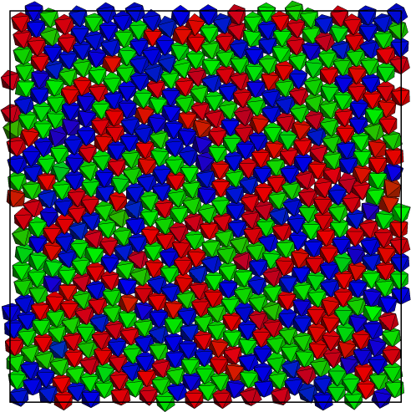
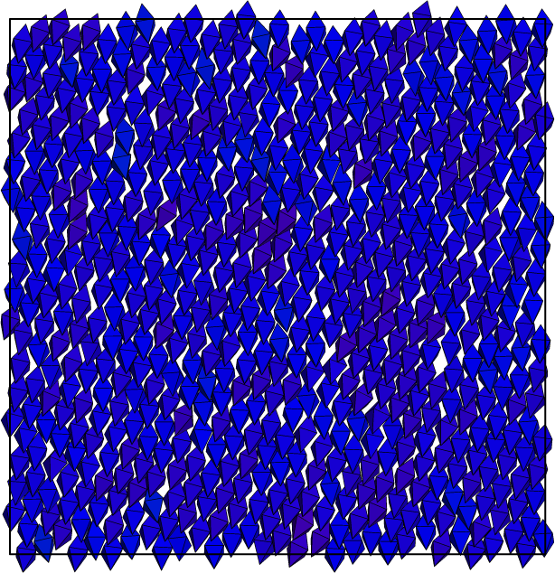
Aspect Ratio

Slide 10
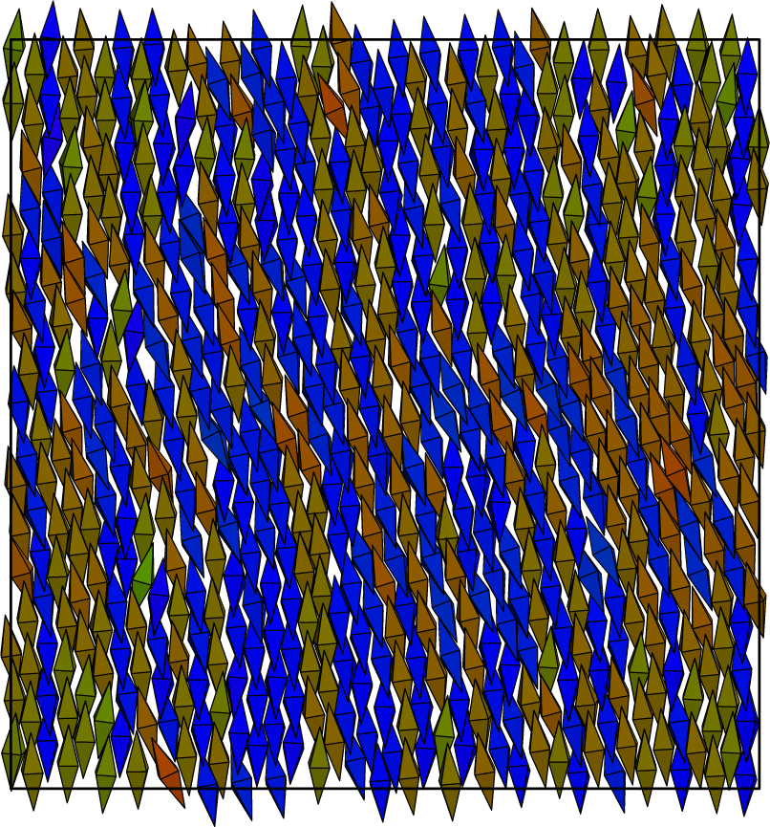
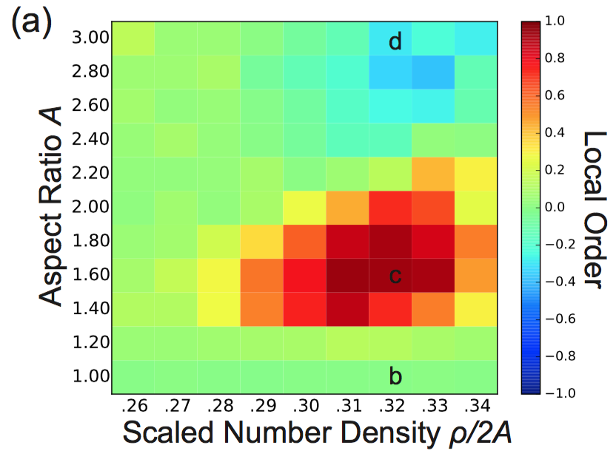
Aspect Ratio

Slide 11

Truncations
Local Directional Order measures if particles are locally parallel or antiparallel.

Slide 12
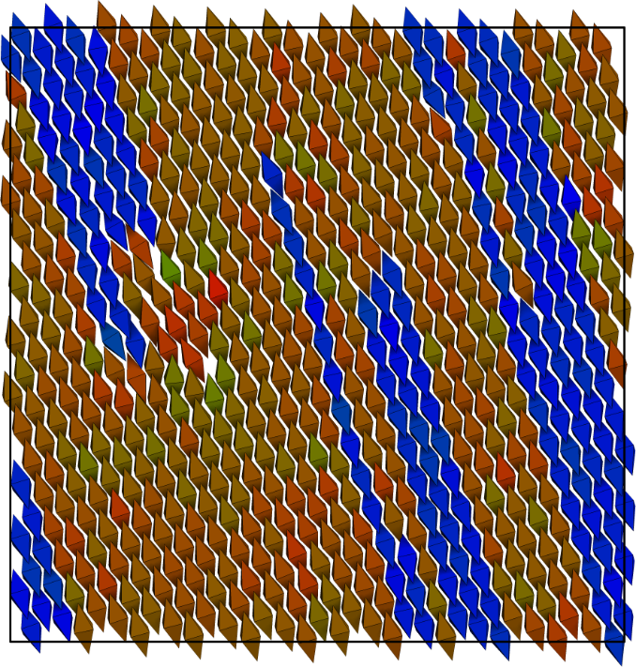
Non-truncated
100nm

Slide 13

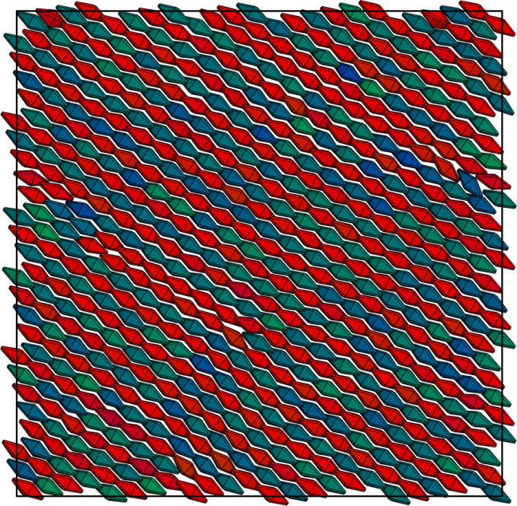
Moderate truncation
100nm

Slide 14
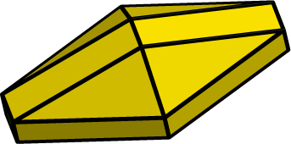
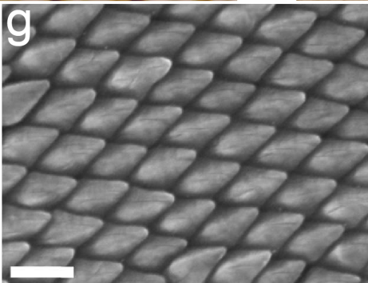
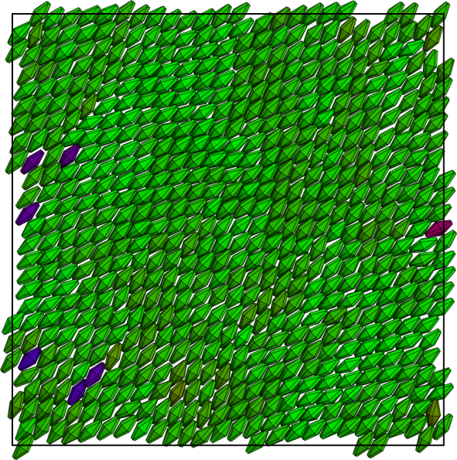
Heavy truncation

Slide 15
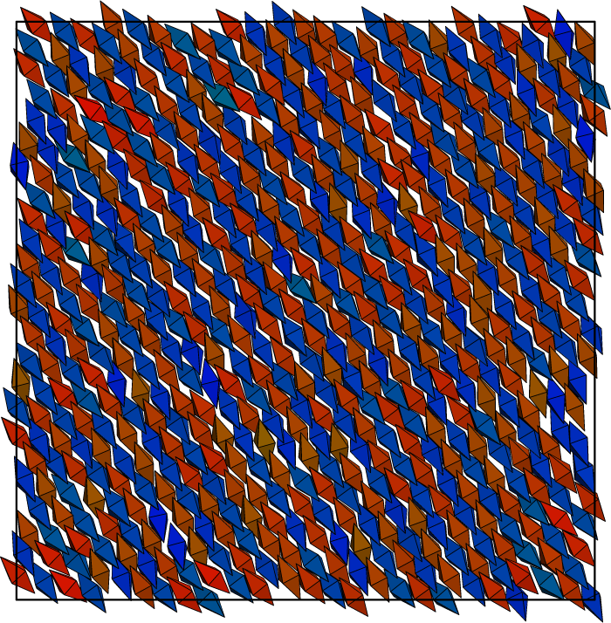
Attractive patchy faces

Slide 16
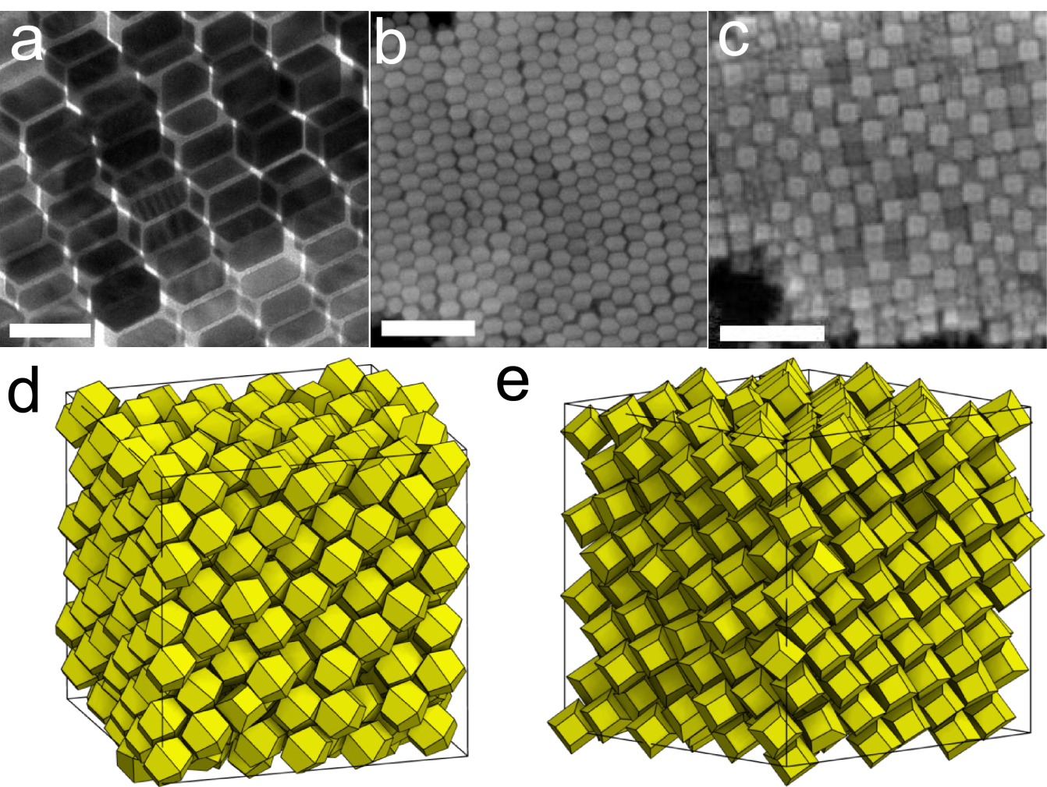
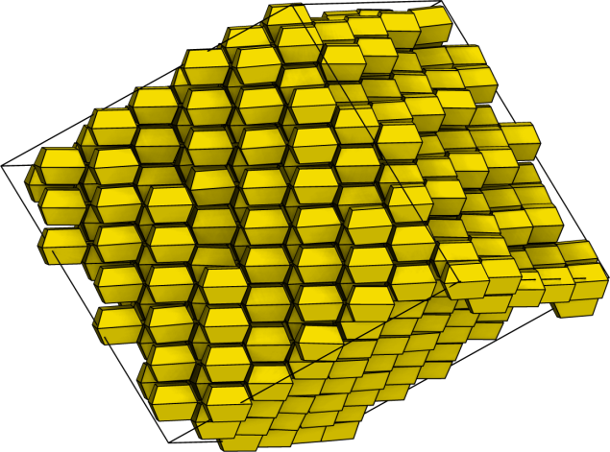
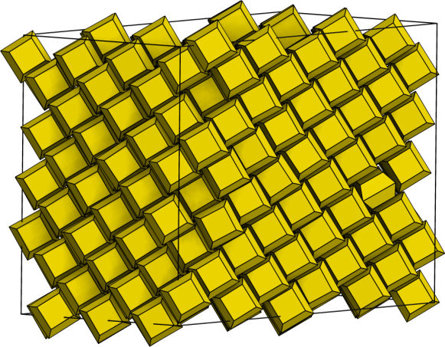
Tip truncations
Body centered tetragonal assemblies
Note: 3D structures, not planar monolayers

Slide 17
Bipyramids concluding remarks
Good parallel phases arise from shorter aspect bipyramids
Hard truncation model sufficient to explain the three bipyramid phases via entropy
Interactions between particles also stabilize the novel antiparallel arrangement

Slide 18
Case 2:
Studying Shape, Structure, and Quality
Shape-Dependent Ordering of Gold Nanocrystals into Large-Scale Superlattices.
Jianxiao Gong, Richmond S. Newman, Michael Engel, Sharon C. Glotzer, Zhiyong Tang [Nature Comm 2016, submitted]
Project Accomplishments:
  Explained the crystallization processes for of each synthesized gold nanopolyhedra
  Identified and motivated the presence of several octahedron superlattices
  Aided in understanding the formation process and crystal quality of the resultant structures

Slide 19
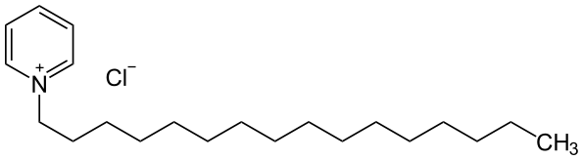
Large superlattice assemblies
Gold nanopolyhedra ~40nm edge lengths
Stabilized with cetylpyridinium chloride in water
Particles sediment

Slide 20
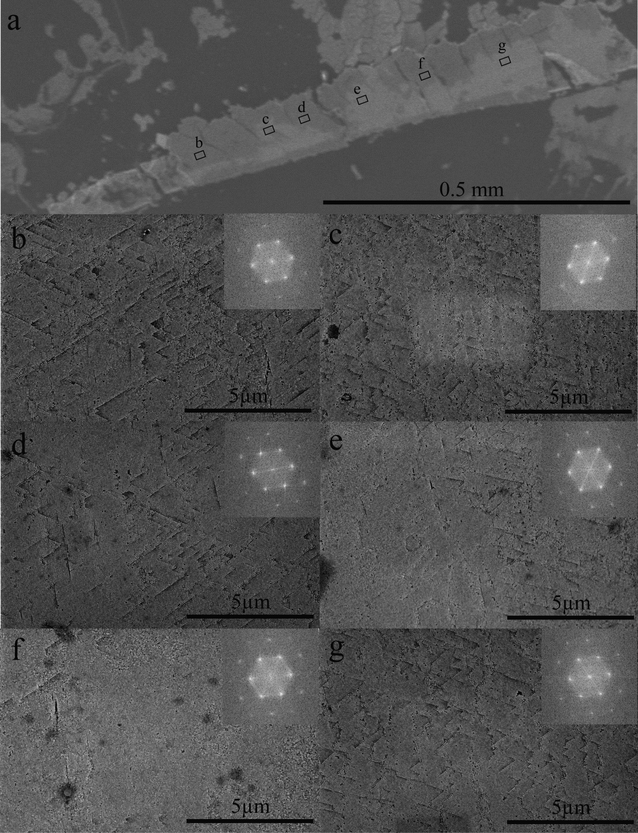
Millimeter-scale
Electron diffractions taken across 0.5mm sample
  Same orientation suggests this is a single domain

Slide 21
Equilibrium NVT Phase Behavior
Simulations (NVT, Hard particle MC). Equilibrium behavior averaged over 10 replicas.
Rhombic dodecahedra and cubes more ‘robust’ in range of tolerant densities for assembly

Slide 22
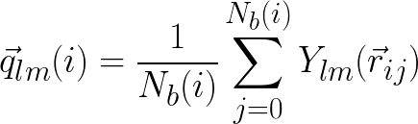


Methods: Finding Crystals from Simulation
Cluster particles i if
Wolde, P. Ten, Ruiz-Montero, M., & Frenkel, D. (1996). Simulation of homogeneous crystal nucleation close to coexistence. Faraday Discuss., 93–110.
Notes:
“Briefly before we begin I wish to discuss some methods that are important, and that I spent time implementing for our research group to share and reuse”
Mention other upgrades of the group analysis code with this, fixing, then eventually reimplementing the periodic boundaries/domain decomposition for performance

Slide 23
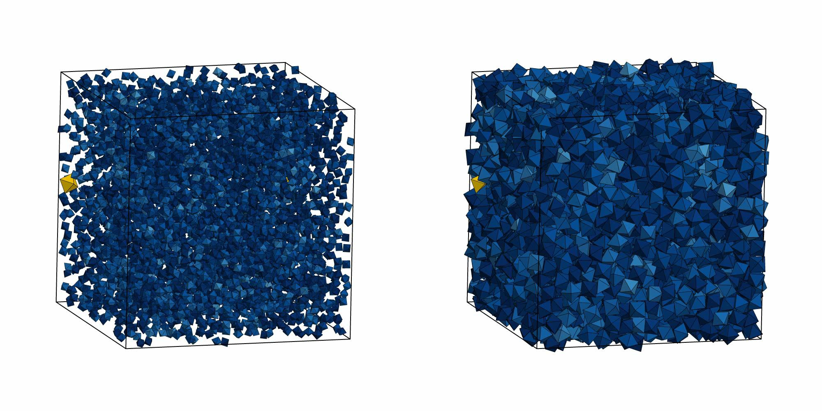
Nucleation and growth

Slide 24
Typical Homogeneous Growth
Columns: 20, 50, and 80% crystalline

Slide 25
Crystallization timescales
Time to nucleate defined by system being 20% crystalline
Growth duration to go from 20-80% crystalline
Diffusion estimates give approximately 10⁴ MC cycles per second
Notes:
Add one row of prior slide to this one.

Slide 26
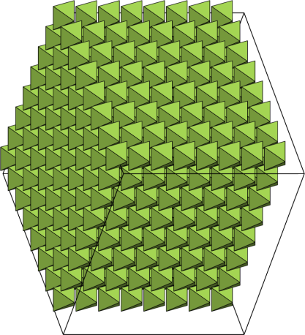
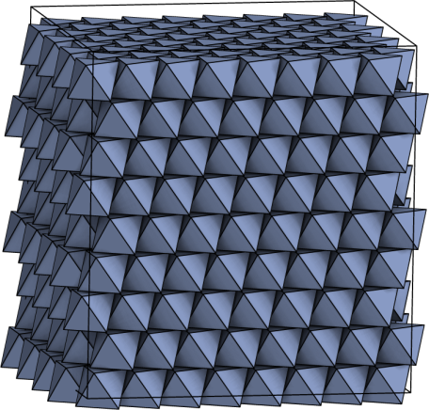
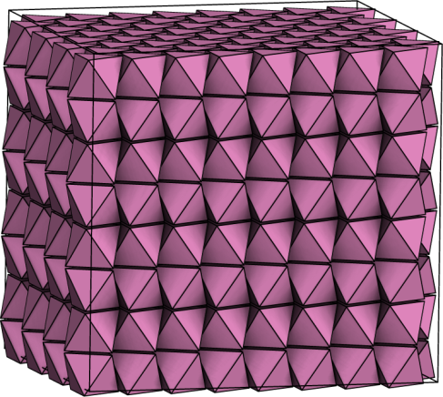
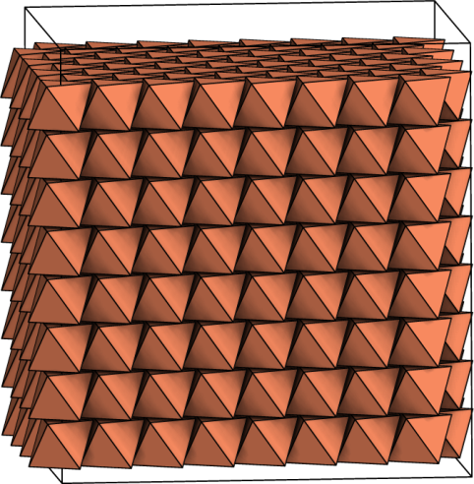
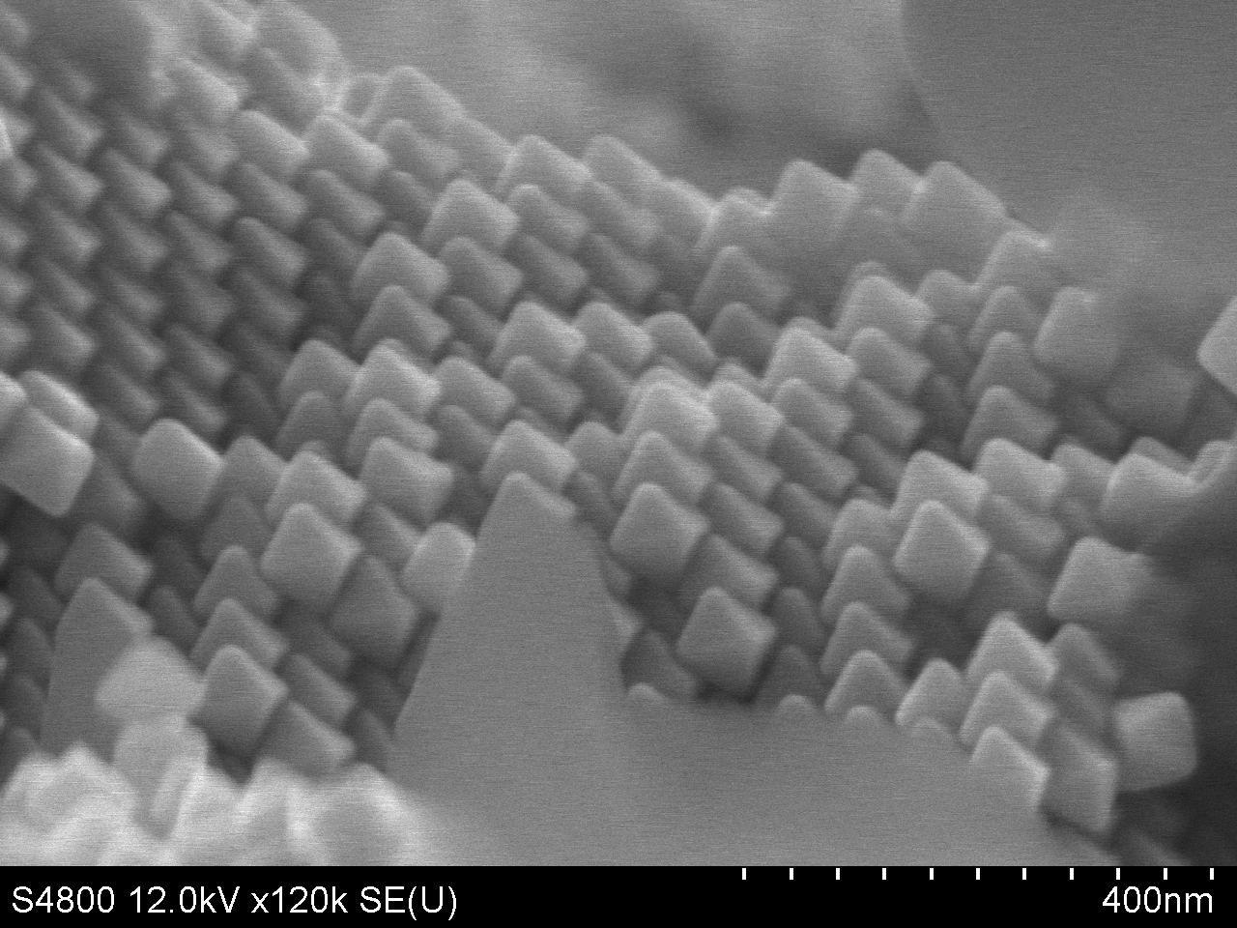
Octahedra Superlattice Polymorphs
Minkowski
Monoclinic
Hexagonal (2p)
Hexagonal (1p)
Notes:
Mention the three (Minkowski/trigonal, Monoclinic, and hexagonal).
Discuss the relative stability (Hard particle access first two).
Discuss hexagonal structure.

Slide 27

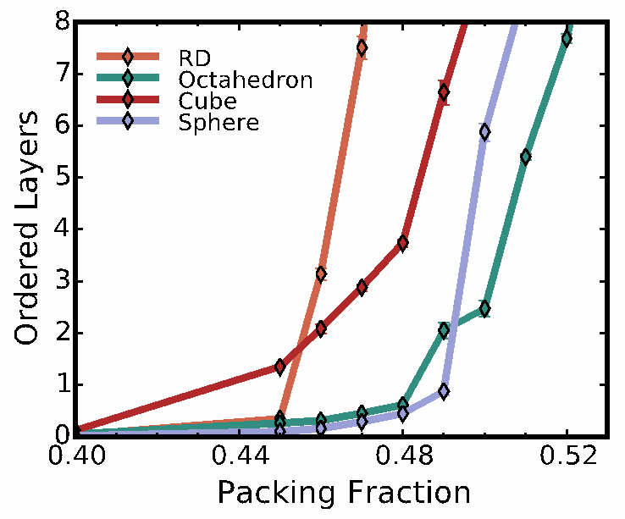
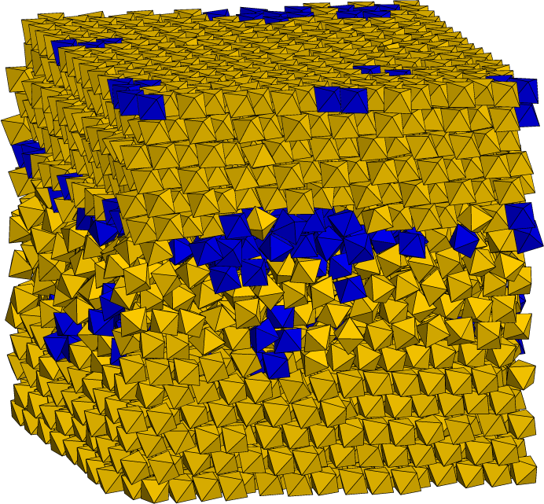
Heterogeneous Nucleation
Notes:
Spheres 51%

Slide 28
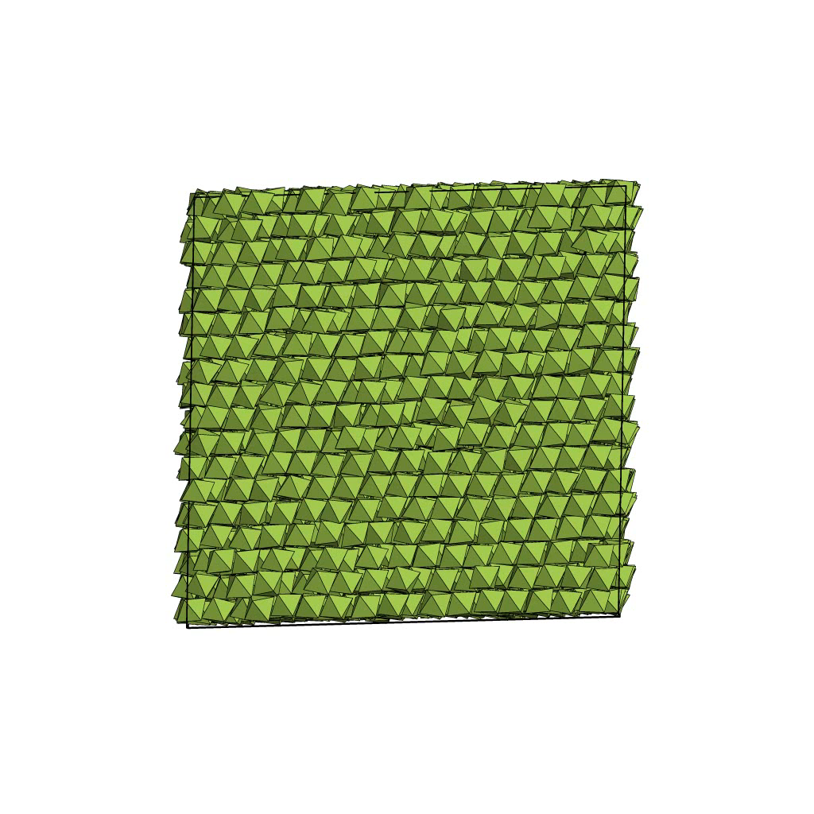
A solid-solid phase transition
Starts as monoclinic
lattice
Fraction ending as monoclinic
Starts as Minkowski
lattice
Packing Fraction

Slide 29
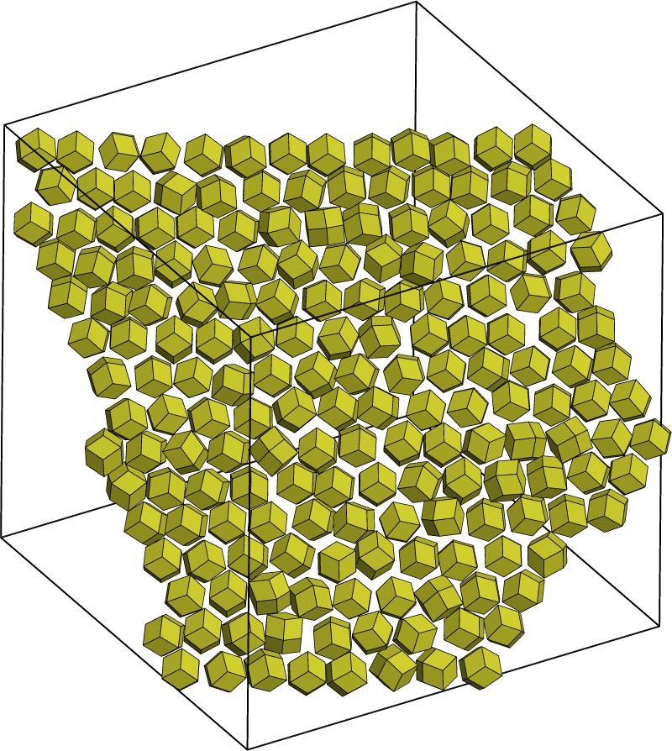
RD: Orientational disorder

Slide 30
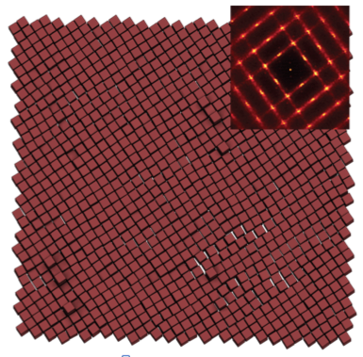
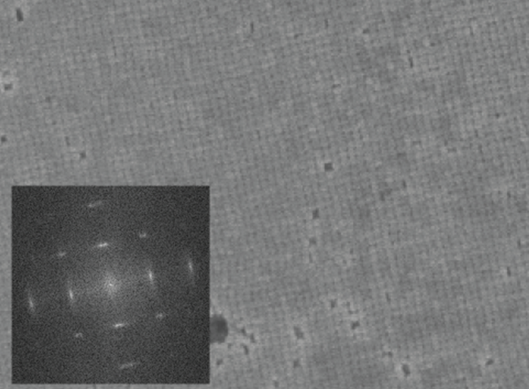
Cubes: Correlated disorder
Positional fluctuations and shearing give rise to anisotropic bragg peaks

Slide 31
Case 2: Concluding remarks
Octahedra structure affected by heterogeneous nucleation control and sedimentation favoring monoclinic packings
Structural Quality
  Rhombic dodecahedra assemble under wide equilibrium conditions but may have orientational defects
  Cubes nucleate easily, but suffer from high vacancy content and local positional disorder
  Octahedra superlattices order well, but with polymorphic equilibrium structures

Slide 32
Case 3: Crystallization Pathways
New Question: How does particle shape affect nucleation processes and the thermodynamics of transitioning from fluid to solid?
Comparing nucleation of rhombic dodecahedra and spheres
Samanthule Nola, Richmond S. Newman, Julia Dshemuchadse, Sharon C. Glotzer. in preparation.
Influence of polyhedral faceting on the crystallization of rotator cubic close packings
Richmond S. Newman, Julia Dshemuchadse, Sharon C. Glotzer. in preparation.

Slide 33



Classical Nucleation Theory

Slide 34
Tool: Rare Events: Umbrella Sampling
Biased Monte Carlo Ensemble
Sample nuclei
sizes
Solid-Liquid Order Parameter
Correct statistics gathered under bias
Compute Free Energy
The point is that we compute nuclei free energies as a function of size
Auer, S., & Frenkel, D. (2004). Numerical prediction of absolute crystallization rates in hard-sphere colloids. Journal of Chemical Physics, 120(6), 3015–29.
Notes:
Consider explaining this slowly, particularly how the ubias/ and acceptance probabilities are calculated upon a system.

Slide 35
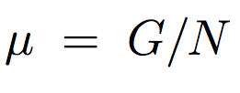

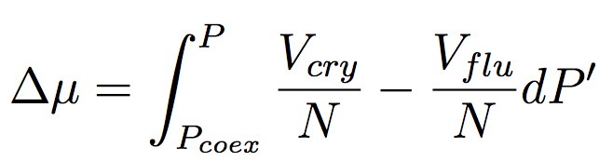

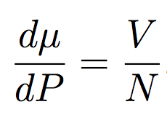
Chemical Potential: Hard Particles
Obligatory Derivation

Slide 36
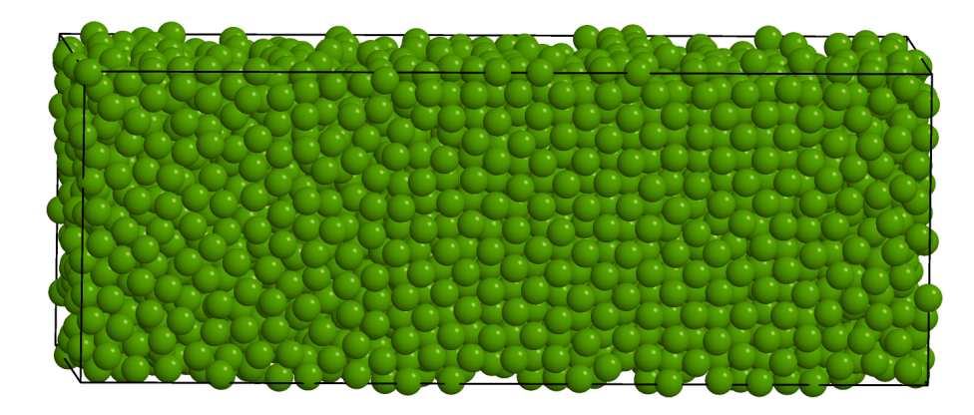
Tool: Interfacial Pinning Determines Coexistence Pressure
Abridged instructions: A two-phase system is carefully constructed, and coexistence is determined when conditions are found where there is no tendency to grow or to melt
Pedersen, U. R., Hummel, F., Kresse, G., Kahl, G., & Dellago, C. (2013). Computing Gibbs free energy differences by interface pinning. Physical Review B, 88, 1–5.

Slide 37


Thermodynamics of the metastable regime

Slide 38
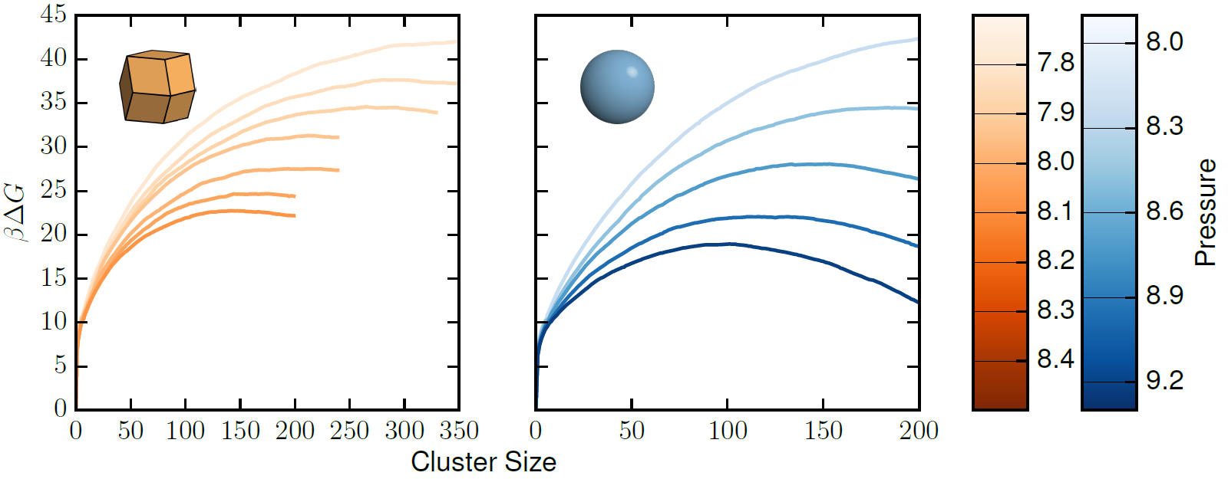
Free Energy Barriers

Slide 39
Free Energy Maxima

Slide 40
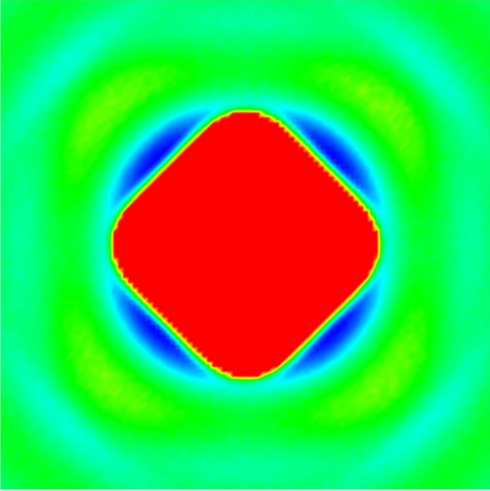
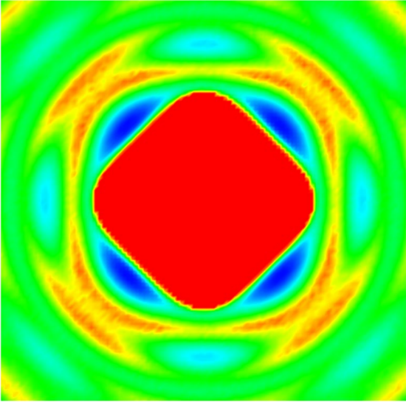
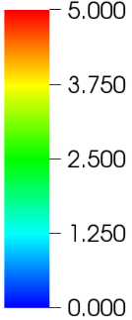

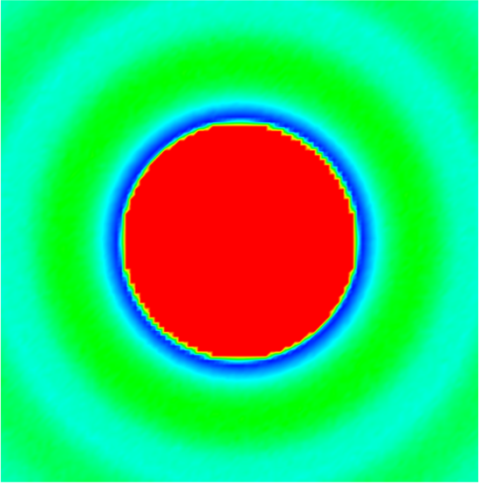
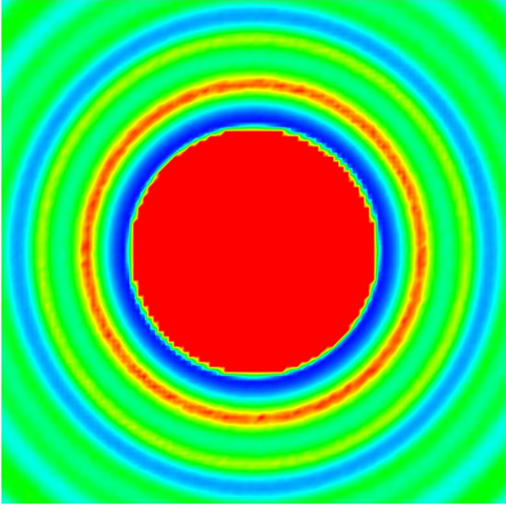

Potential of Mean Force & Torque
Expresses local ordering around particles
βF

Slide 41

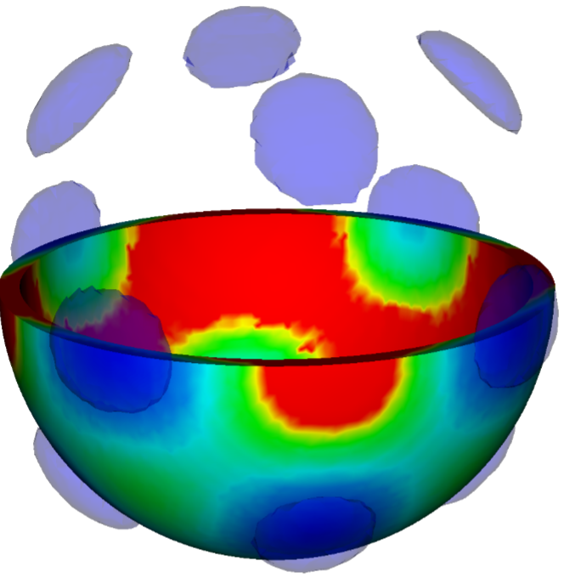
Potential of Mean Force & Torque
βF

Slide 42

Role of Faceting on Nucleation
Study a continuous truncation of rhombic dodecahedra to rhombicuboctahedra that self-assemble face-centered cubic crystals
As the change is continuous we can compare and better understand the role of shape directly

Slide 43

Thermodynamics

Slide 44
Free Energy Barrier Heights

Slide 45







Potentials of Mean Force & Torque
PMFT data for the family (top row liquid, bottom solid).
Truncation undermines local ccp ordering

Slide 46







Nucleation concluding remarks
Truncations of a rhombic dodecahedra weaken directional entropic forces
Free energy calculations of cluster sizes, and find the truncation causes free energy barriers to rise at given driving forces.
Local structural motifs in the fluid provided by the building block stabilize the nucleation pathways

Slide 47






Overall concluding remarks
Free Energy Barrier Height
Shapes effect both equilibrium assembles and their formation pathways

Slide 48




Future Outlook
Nucleation in many polyhedra require local environments to change symmetry
  How will this affect driving forces?
Molecular dynamics of shaped particles allows for faceted particles for direct timescales
DDT
TGR

Slide 49








Acknowledgements

